Slide 1
Modules

Slide 2
Modules
A language C++ compiler consists of a very compact kernel and a variety of modules (libraries) that can be linked when needed.
Each library function has a prototype in the appropriate header file *.h
The programmer can select which library functions he will use and link the appropriate header files to his app.

Slide 3
Modules
Working with large projects, sometimes easier to split the program into several files Some functions may be described in header files *.h
And implemented in modules files *.cpp
Which are linked to the main program by using the #include directive.

Slide 4
Module exaple
cmath- Mathematical functions
cstring - String functions
ctime - Date and time finctions
In modern notation .h is not used any more, only in some special cases when you need to use old libraries.

Slide 5

Program example
float Mult (float a, float b)
{return a*b;}
float Div (float a, float b)
{return a/b;}
float Sum (float a, float b)
{return a+b;}
float Diff (float a, float b)
{return a-b;}
int main()
{
int x=20, y=2;
cout << Mult(x,y) << endl;
cout << Div(x,y) << endl;
cout << Sum(x,y) << endl;
cout << Diff(x,y) << endl;
system("pause");
return 0;
}
All functions including main in a single file.

Slide 6

Program example
mymath.h
moduli2.cpp
float Mult (float, float);
float Div (float, float);
float Sum (float, float);
float Diff (float, float);
#include <iostream>
#include "mymath.h"
using namespace std;
int main()
{
int x=20, y=2;
cout << Mult(x,y) << endl;
cout << Div(x,y) << endl;
cout << Sum(x,y) << endl;
cout << Diff(x,y) << endl;
system("pause");
return 0;
}
mymath.cpp
float Mult (float a, float b)
{return a*b;}
float Div (float a, float b)
{return a/b;}
float Sum (float a, float b)
{return a+b;}
float Diff (float a, float b)
{return a-b;}
mymath.h and mymath.cpp creates a module, file names have to match! moduli2.cpp main program.

Slide 7
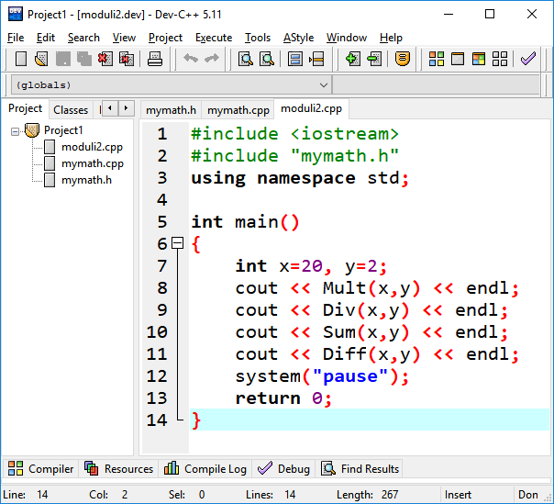
Program analysis
To get the working program, you must create a project and attach all the files to it.

Slide 8
Program analysis
mymath.h – function prototypes file
mymath.cpp – function implementation file
moduli2.cpp – main program
#include <iostream>
#include "mymath.h"
using namespace std;
int main()
{
…
#include "mymath.h" – must use quotation marks if the module file is in a different location than the standard modules. In our case it is the current folder.

Slide 9
Practice
Create module converters describing the following functions
MeeterToFeet
FeetToMeeter
KmhToMS
MSToKmh
CelsiusToFarenheit
FarenheitToCelsius
Test functions in the main program.

